Slide 1

Performance Evaluation of an Exam Session
Chiara Bonsignori
Alessio Ercolani
Sara Lotano

Slide 2


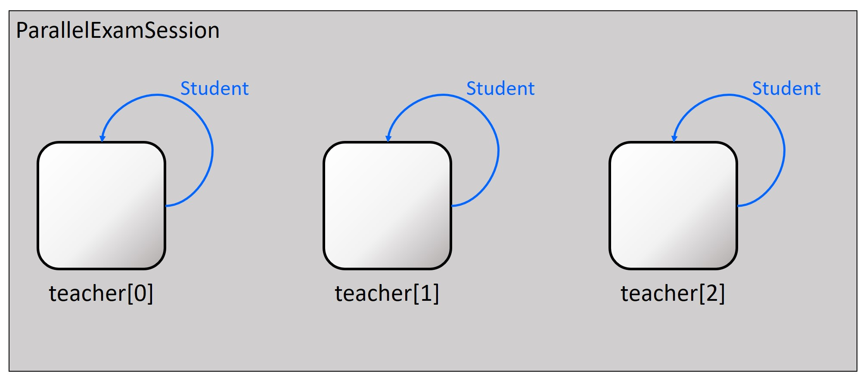
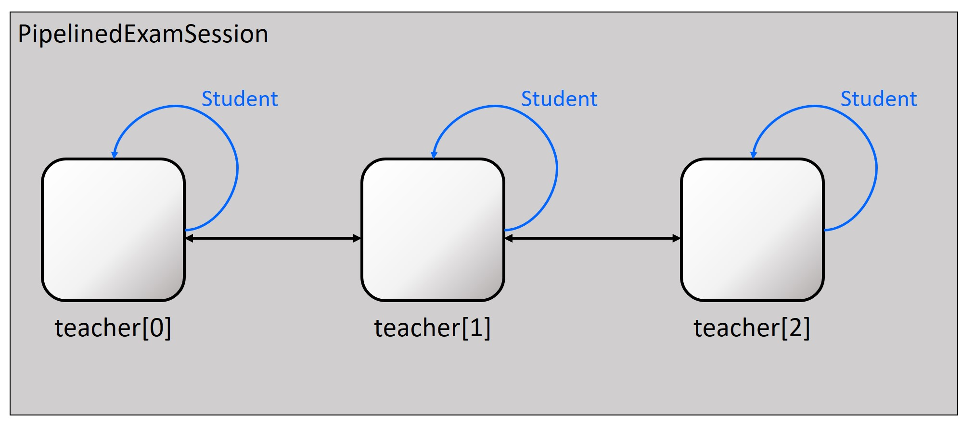
Introduction
Goals
Evaluate performances of an exam session
Parallel system
Pipelined system
Assumptions
Instantaneous communications
No overhead to think about new questions
Instantaneous movements
Models
Two different OMNeT++ Networks
Student implemented as cMessage
1

Slide 3
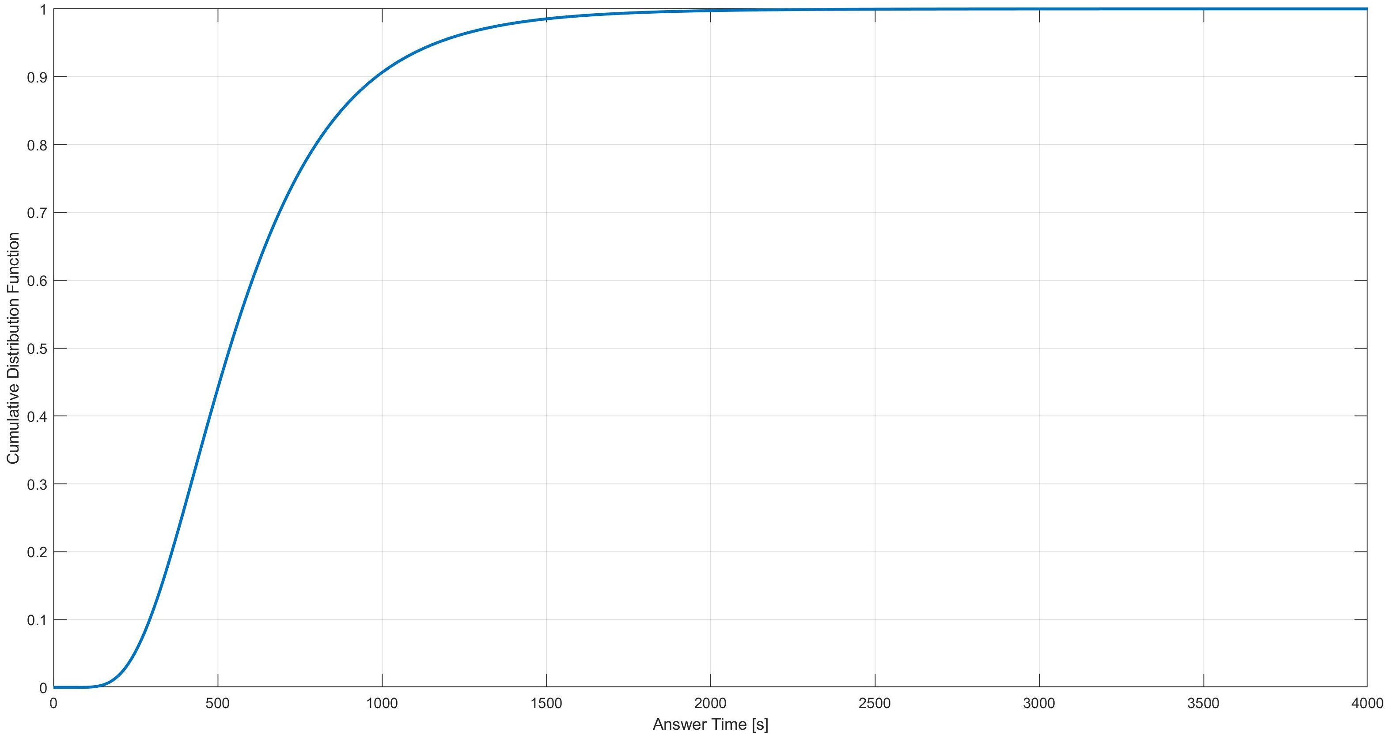
Scenarios
Performance indices
Examination Time
Only for Pipelined system
Waiting Time
Idle Time
Factors
Distributions for Answer Time t [s]
t ~ U(300, 900)
t ~ LN(6.2854, 0.4724)
Number of teachers N = {1, 2, 3, 4, 5, 6, 7}
Equals to the number of questions
Parameters
Warm-up time ≈ 16 hours
Simulation time ≈ 4 days
30 repetitions
1 RNG
2

Slide 4
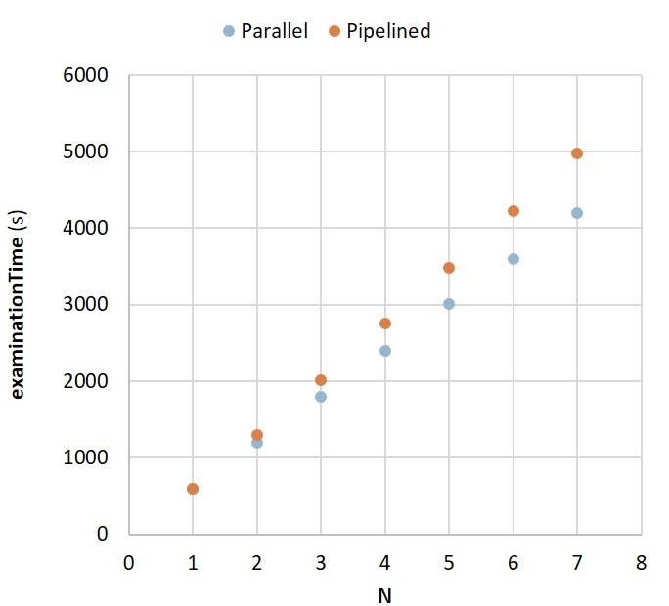
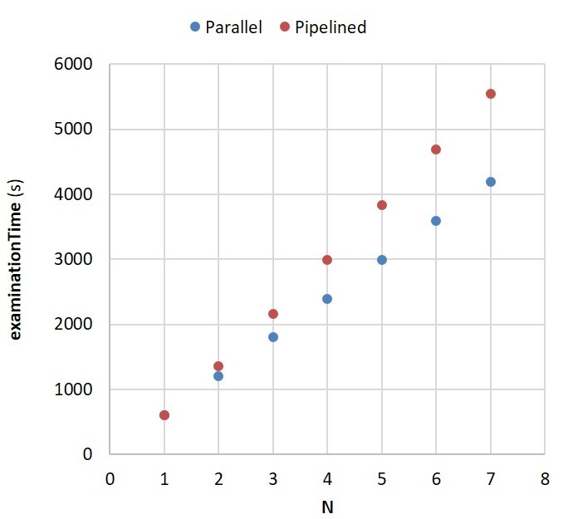
Examination Time
“gap”
“gap”
Uniform scenario
Lognormal scenario
Increases with N
“Gaps” grow with N in both distributions
especially in the lognormal scenario
3

Slide 5
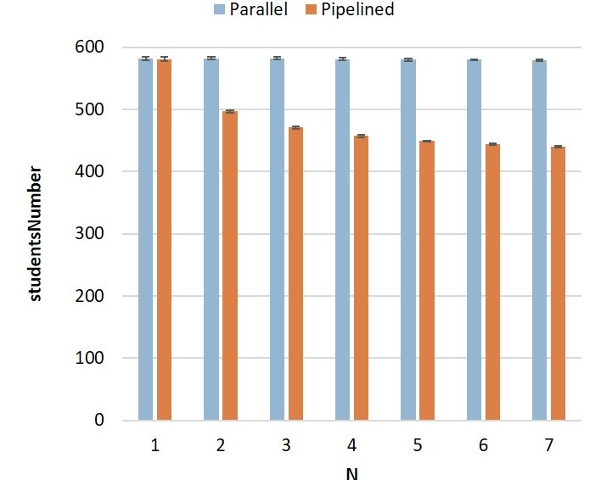
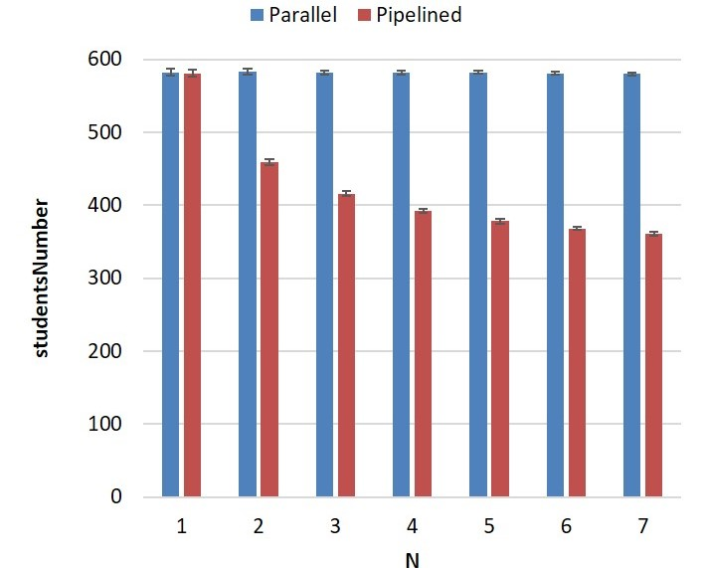
Number of examined students
Uniform scenario
Lognormal scenario
In the Parallel system is independent from N
In the Pipelined system decreases with N
4

Slide 6
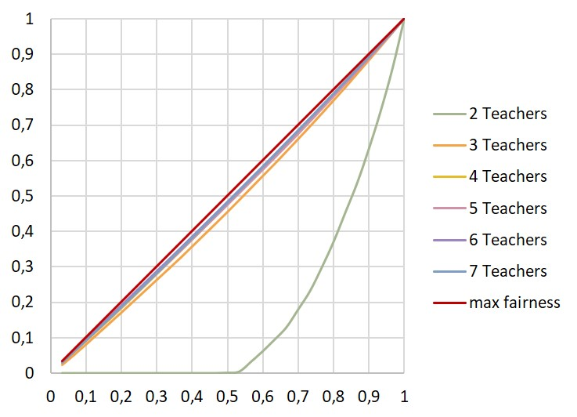
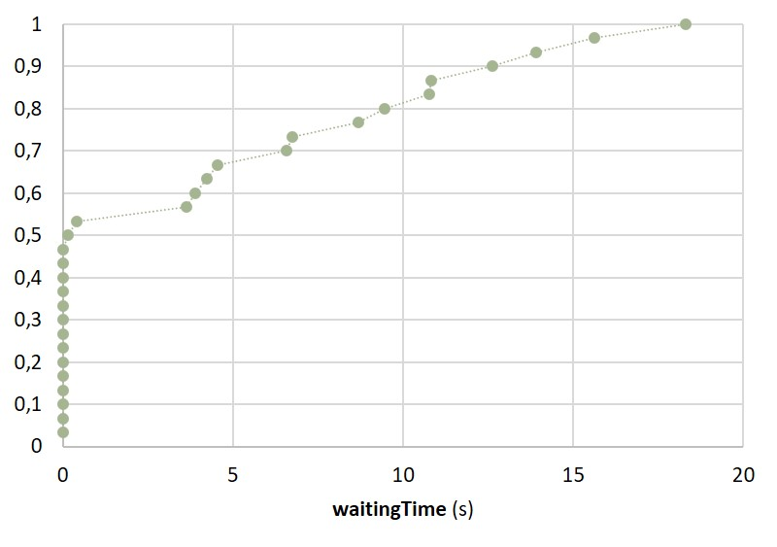
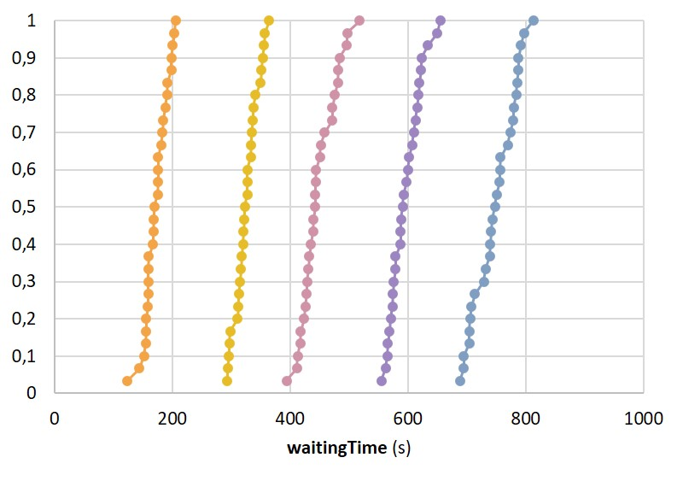
Waiting Time (1/2)
Lorenz Curves – Uniform scenario
ECDFs – Uniform scenario
For N = 2 system is unfair
For N ≥ 3 system tends to the line of maximum fairness
Same behavior for the lognormal scenario with higher LCGs
5

Slide 7
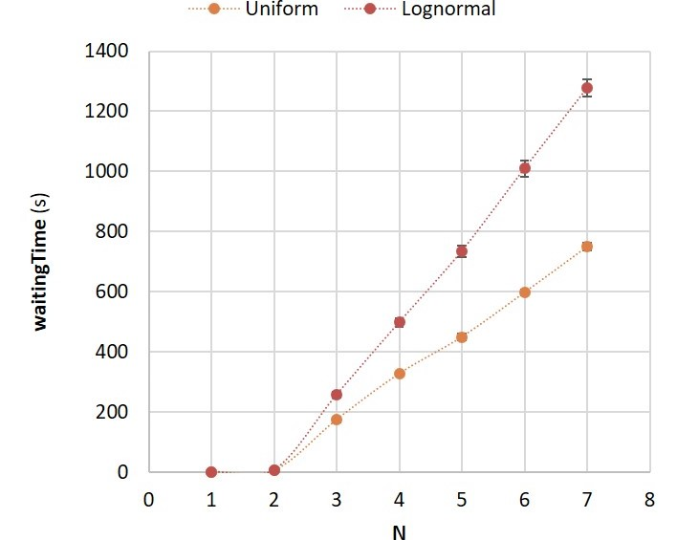
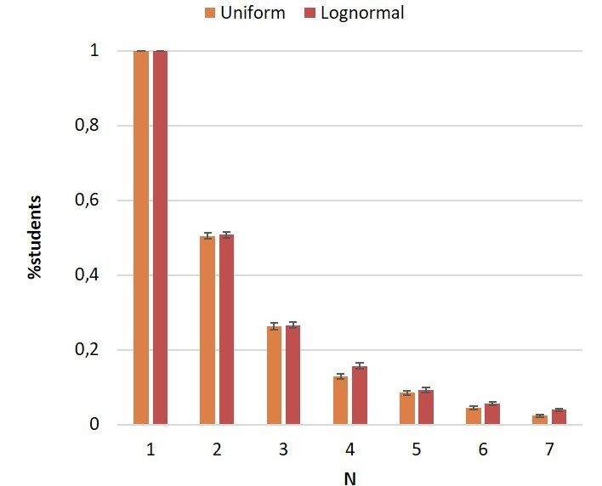
Waiting Time (2/2)
Waiting Time increases with N
in particular in the lognormal case
Percentage of students with zero waiting time decreases with N
6

Slide 8
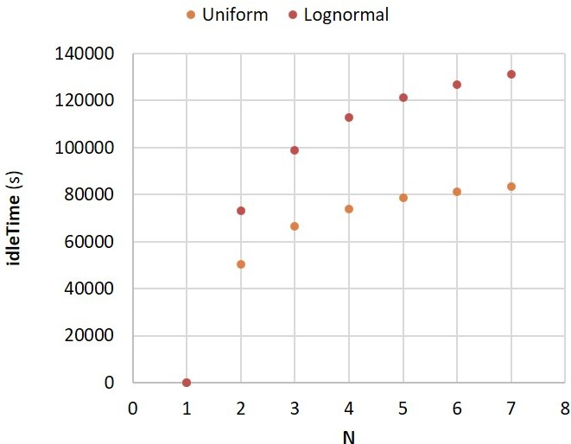
Idle Time (1/2)
Mean idle time for the exam committee increases when the number of teachers grows
Percentages of idle time with respect to the total simulation time can reach high values
N | 1 | 2 | 3 | 4 | 5 | 6 | 7
Uniform | 0% | 14% | 19% | 21% | 22% | 23% | 24%
Lognormal | 0% | 21% | 28% | 32% | 35% | 36% | 37%
Mean idle time for the exam committee
Percentages of idle times over simulation time
7

Slide 9
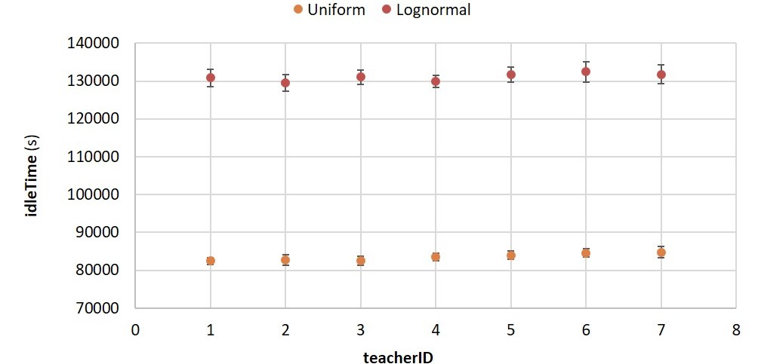
Idle Time (2/2)
Mean teacher’s idle time (N = 7)
Teachers’ idle time doesn’t depend on their position in the pipeline
8

Slide 10
Conclusions
N | 1 | 2 | 3 | 4 | 5 | 6 | 7
Uniform | 0% | 14% | 19% | 21% | 22% | 23% | 24%
Lognormal | 0% | 21% | 28% | 32% | 35% | 36% | 37%
Examination Time
Always smaller in the Parallel system
Number of examined students
Constant in the Parallel system
Decreases in the Pipelined system
Waiting Time
For N = 2 there are different exam experiences for students
For N ≥ 3 exam experience become homogeneous
Idle Time
Teachers can have low productivity
Independent from teachers’ position
Lorenz Curves – Uniform scenario
Lognormal scenario
Uniform scenario
Uniform scenario
Lognormal scenario
Mean teacher’s idle time (N = 7)
9

